Slide 1

CMYSL Coaching
Meeting
August 2025

Slide 2
Agenda
CMYSL Leadership Team
Playing Fact Sheet
Fines List
Rosters
  Photos
  Coaching Credentials
  Player Uniform #
  Printing Roster
Game Day
  Game Readiness (CORI)
  The Game
  Score Reporting
  Referee Evaluation
Sportsmanship Card Reading
Codes of Conduct
Derogatory Language / Discrimination
Respect the call 531-9 Policy
Sportsmanship
Referee (Key messages)
Weather / Cancellations
Postponements / Rescheduling
Key Dates
Resources

Slide 3
CMYSL Leadership Team
Rick Porter – President
  president@cmysl.com
Mike Poe – Vice President
  vicepresident@cmysl.com
Jeff LaBonte – Treasurer
  treasurer@cmysl.com
Marcia Perron – Secretary
  secretary@cmysl.com
Thierry Mann – Sportsmanship
  Sportsmanship@cmysl.com
By board appointment
  Mark McGown – Referee Assignor
    refassignor@cmysl.com
Brandon Sexton– U10 Boys Registrar
  U10boys@cmysl.com
Rich Thomas – U10 Girls Registrar
  U10girls@cmysl.com
Nicole LeBlanc – U12 Boys Registrar
  U12boys@cmysl.com
Dan Salvas – U12 Girls Registrar
  U12girls@cmysl.com
Tim Denomme – U14 Boys Registrar
  U14boys@cmysl.com
John Christina – U14 Girls Registrar
  U14girls@cmysl.com
Jim Soto – U16-U18 Boys & Girls Registrar
  U16-19@cmysl.com

Slide 4
CMYSL Resource items
Laws of the game: theifab.com
  Modifications for U10: No heading, No slide tackling, defending team retreats to half on goal kicks
  Modifications for U12: No heading
We have a website with a lot of data cmysl.com
Dedicated section for “Coach Resources”
  Adult Registration Process
  Game Feedback Form
  Rescheduling Games
  Roster, Schedule, and Game Scoring
Key policy items are in the “About Us”
  Competition Policy
  Sportsmanship Policy
  Playing Fact Sheet

Slide 5
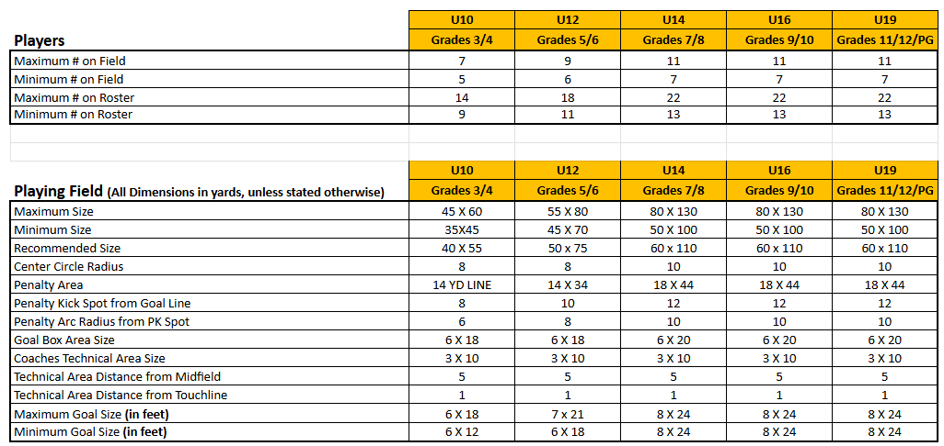
Fact Sheet

Slide 6
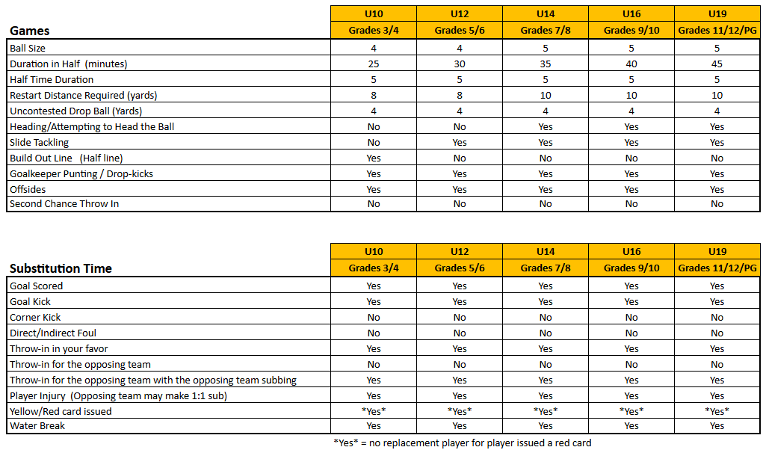
Fact Sheet (Cont)

Slide 7
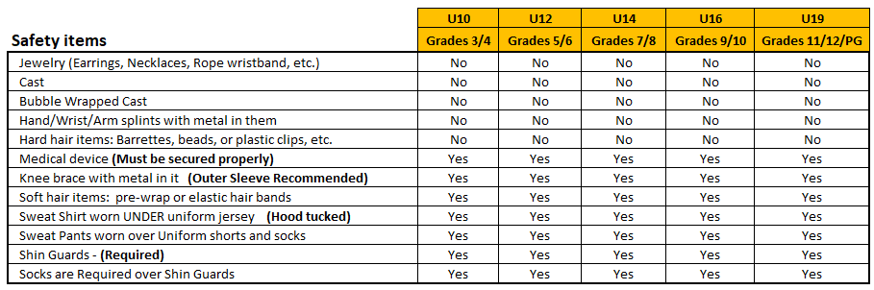
Fact Sheet (Cont)
No earrings! No tape over earrings!! If the player wants to play – they must come out!

Slide 8
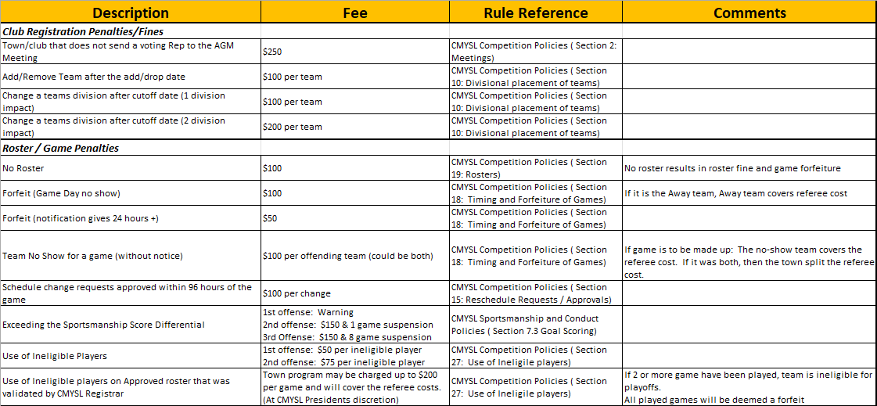
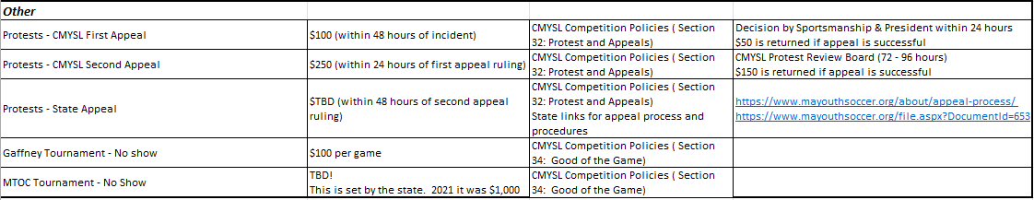
Fact sheet - Fines

Slide 9
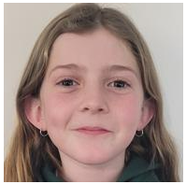
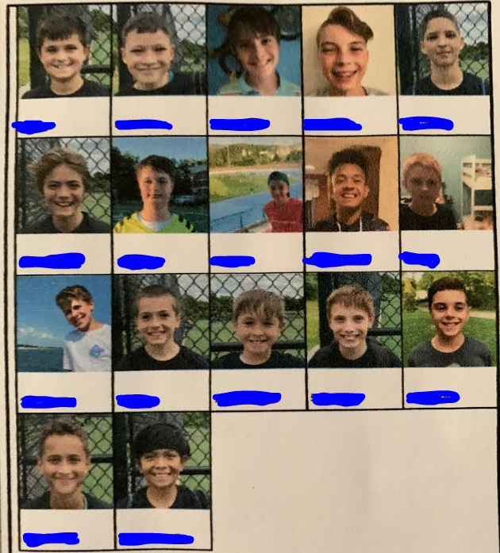
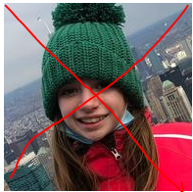

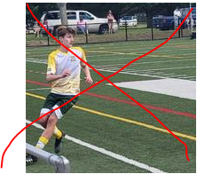
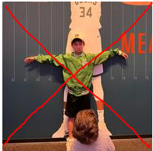
Rosters – Photos
Photos should be passport like!
  Head shot
  Facing front
  Plain background
  No Hats
  No Animals
  No generic images

Slide 10
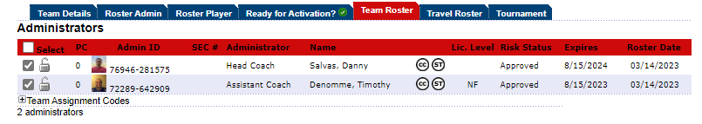
Rosters – Coaching Compliance
Coaches need 3 Items to be approved on a roster
  CORI Approved, (CC)Concussion Certified, (ST) SafeSport Trained
Links: https://mayouthsoccer.org/resources/adult-registration/
Risk Status (CORI); CC, and ST

Slide 11
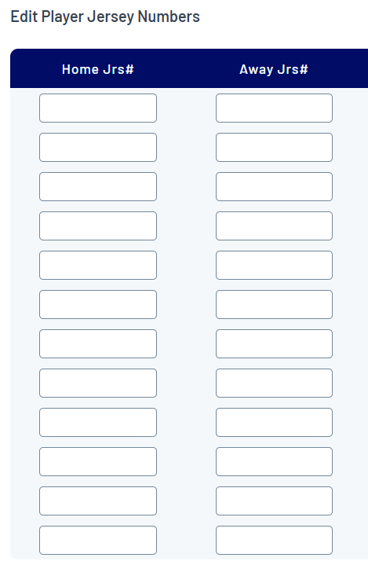
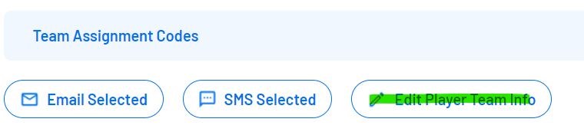
Rosters – Uniform numbers
Coaches are responsible to add uniform numbers onto the roster. Not the Referee!
SportsConnect – Club view
Team Central / Team Directory
Select the Go to Tournament & Schedule Apps
View Tourn Aps
Under the Team Assignment Codes
Select Edit Player Team Info
Add the players numbers in both home and away field

Slide 12
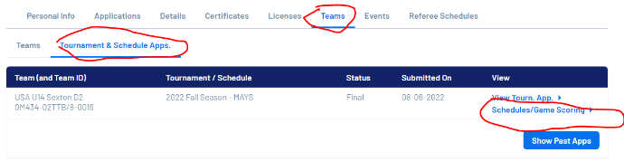

Rosters – Printing
Login to your town’s org
Team Central / Team Directory
Select the Go to Tournament & Schedule Apps
Schedule / Game Scoring
Print Roster

Slide 13
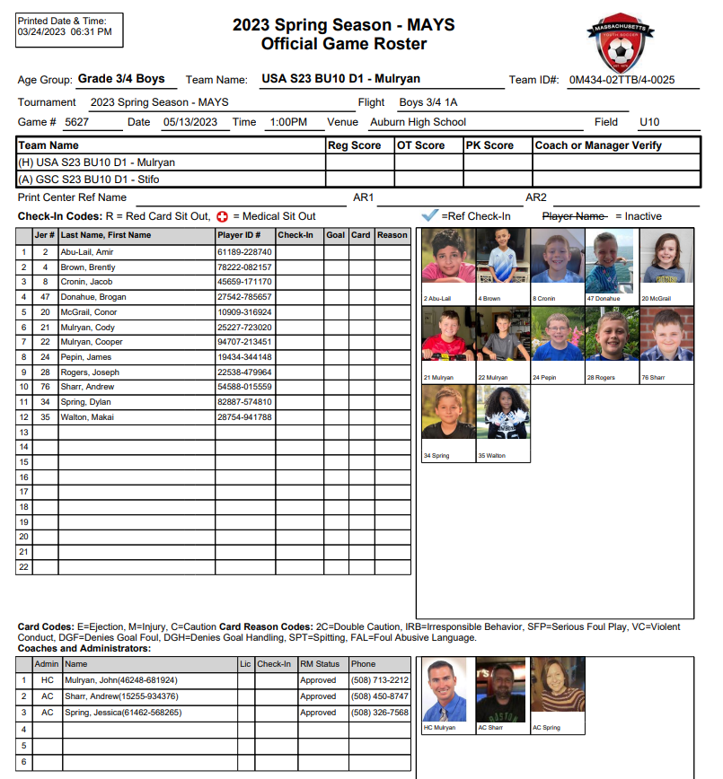
Roster!

Slide 14
Game Day – Check in
Must have 2 paper copies to give to the referee
  If 2 copies are in Color – Great!
  If 2 copies are in B&W, must have a “Golden” color paper copy to use for check in
    Can be laminated!!
    MUST be in paper form
    No Phone roster!
    Referees have been instructed to accept this and give the golden copy back to you
No roster – Team without roster forfeits game
  Team has within the 15 minute grace period to produce a roster otherwise the referee will abandon the game and leave the field
    Follows the Timing and Forfeiture within the Participation Policy

Slide 15
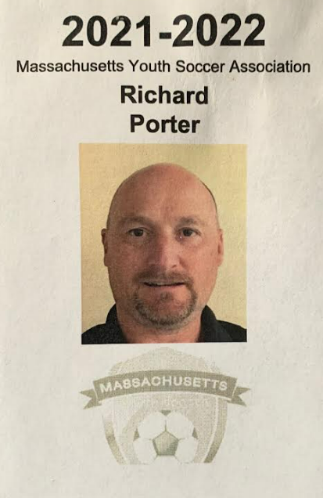
Game Day – Check in Cont.
All coaches must have their Coaching credentials
  Picture being on the roster is not fully compliant
Referee’s have been instructed to ask for them
  If you do not have yours at the game, you will be asked to move to the spectator's sideline

Slide 16
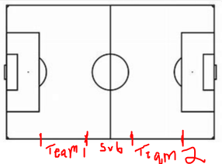
Game Day – The Game
Only 3 coaches on the sideline – regardless of how many coaches are approved on the roster
All players must sub on/off from midfield
Bench area: top of circle to top of Penalty Area
If 1 or no subs – consider a hydration break
  If one team asks for it – it will be grant it
  If the referee asks for it – please accept it without question
  Clock runs during hydration breaks
Make sure you get a copy of the other team's roster from the referee with the score and winner clearly identified
U10 build out line – goal kicks only – use the half field line

Slide 17
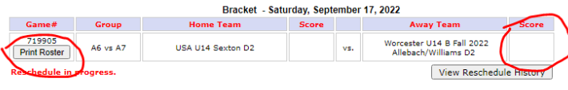
Rosters – Score Reporting
Login to your town’s org
Team Central //Team Directory
Select the Go TO MA Youth Soccer
Teams & Tournament & Schedule Apps
Schedules / Game Scoring
It will bring up the list of games
Choose the correct game, enter final score

Slide 18
Game Day – Referee Evaluation
Our Sportsmanship Director has created a feedback form
This gives the coach a place to provide a game summary and constructive feedback on the referee
If the referee shows up 5 minutes before the game, we want to know
  Unless they contacted you stating that they would be coming from another game and will be getting there close to game time
https://app.smartsheet.com/b/form/08bb4adb3b784c0eb951dd70da297114

Slide 19
Sportsmanship Card Reading
New process being used in all leagues across the state
Procedure:
  After all pre-game activities are complete, both teams and the referee crew will line up at the Halfway Line of the Coaches Sideline.
  Led by officials, all players and coaches will walk across the field and line up facing spectators, 5 yard from the sideline.
  The Sportsmanship Statement will be read by a representative of the Home team to all coaches, players and spectators.
  Following the reading of the script, players will perform a pre-game handshake. (Home team to walk down the line of Away Team). After the pre-game handshake, all players and coaches will return to benches and starting players will assume positions on the field of play.
  No official post game handshake
Statement to be read by a home team representative:
  All participants deserve the right to play in an environment free from hostile and distracting behavior.
  Poor sportsmanship will not be tolerated; the game may be stopped and sanctions applied for violations of policy or codes of conduct.
  Please enjoy the game and do your part to create a positive soccer experience for all.

Slide 20
Codes of Conduct
The state spent a lot of time and energy in updating safety items and codes of conduct for everyone’s benefit
6 dedicated codes that became effective February 1, 2023
  Zero Tolerance Policy
  Player’s Code of Conduct
  Coach’s Code of Conduct
  Parent’s / Guardian’s / Spectator’s Code of Conduct
  Soccer Official’s Code of Conduct
  Language Incidents & Discriminatory Acts Response Guideline
All of these can be found on the MA Youth website
https://mayouthsoccer.org/codes-of-conduct/
For the good of the game!
  Tobacco use, smoking of any kind, electronic cigarettes, alcohol, and artificial noisemakers are prohibited at any CMYSL game

Slide 21
Derogatory Language and/or Discrimination
Derogatory Language and or Discriminatory Actions have been on the rise between players
  9 page policy within Code of Conduct provides guidance for Coaches, Players, Spectators, and Referees
Main points for this meeting
  Referee’s that hear/see the action are to follow IFAB laws of the game
  Referee’s that do not hear/see the action, but an action is reported to them:
    Will pause the match at next appropriate stoppage (and stop the clock) to collect the facts
    Send all players back to their bench
    Call all the coaches together to explain what was reported as best they can
    Coaches, we need your support to resolve the issue immediately
If the coaches are uncooperative, or a resolution cannot be initiated/reached within 5 minutes, the referee could resume or abandon the match based on the safety of the environment

Slide 22
Respect the Call 531-9 Policy
Effective March 1, 2025, US Soccer updated its Referee Abuse Policy with the goal to make youth and amateur matches safer, more fun, and more empowering for everyone involved
https://9tcud.r.ah.d.sendibm5.com/mk/cl/f/sh/1t6Af4OiGsE8LUNFkN0iMHoUeza6Sb/_g1KzJVenlvb
Referee-Abuse-Policy-531-9-Penalty-Summary.pdf
MA Youth Soccer has also approved a spectator policy, which extends the same minimum penalties
https://9tcud.r.ah.d.sendibm5.com/mk/cl/f/sh/1t6Af4OiGsEagCZg8j6dWXsK2oYqAf/UmhB09FdFXaL
Link to a 2 minute video
mayouthsoccer.org/wp-content/uploads/2025/03/U.S.-Soccer-RAP-Video.mp4

Slide 23
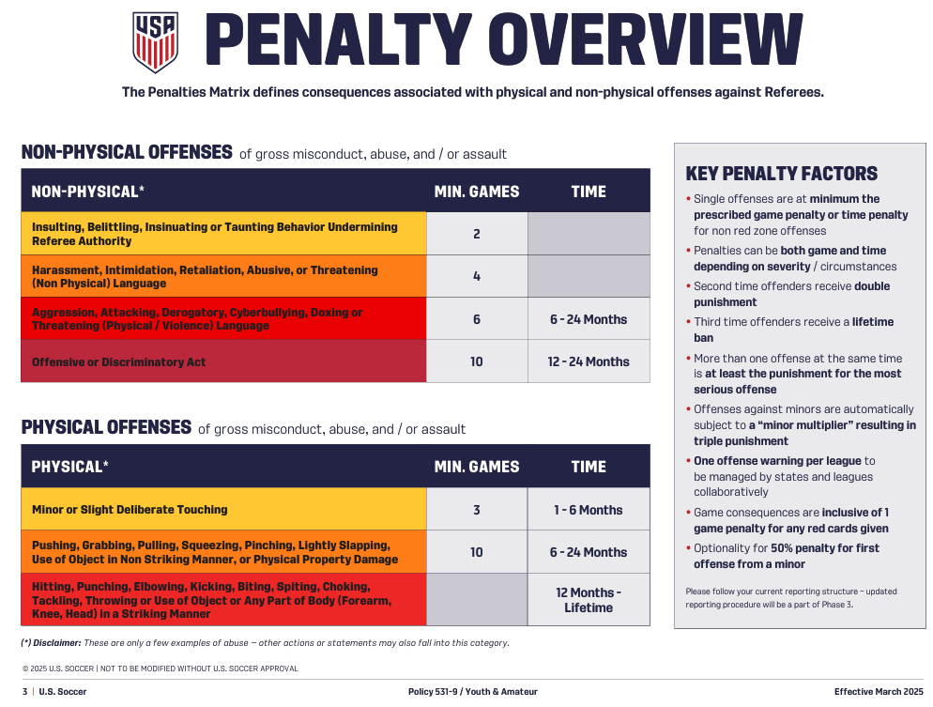

Slide 24
Respect the Call 531-9 Policy
Coaches, Players, and Spectators will be suspended for ALL instances for the number of games and/or time in ALL levels of play
  If a coach plays in a Sunday morning league, coaches 2 town teams and 2 club teams
    That coach is not allowed to participate in ANY of those events until suspension is completed
  Example: Coach was found guilty of Non-Physical Intimidation
    This carries a minimum 4 game suspension
      No playing in your adult league for the 4 games
      No coaching either town team#1 for the 4 games
      No coaching either town team#2 for the 4 games
      No coaching either club team#1 for the 4 games
      No coaching either club team#2 for the 4 games
    This 4-game suspension impacted 20 events for that coach!
  If this coach is also a badged referee
    They are NOT allowed to officiate any matches during this suspended time

Slide 25
Sportsmanship
Goal Differential
  8 goal difference (or more) is a problem!!
  We average ~12 of these a season
  DON’T wait until it you have a 6-goal differential to change your playing style
Applaud all good plays by both teams
Don’t yell across the field at players from a bad play
  Pull the player aside once subbed and use as a teaching moment
    What other options did he/she have?
Coaches are responsible for Spectator comments
  If you hear things coming from the spectator sideline – please fix it before it escalates

Slide 26
Sportsmanship Cont.
Incident Notifications
  Will typically come from Sportsmanship Director or President
  Data into the board might come from 3-4 sources
    Referee report through Arbiter
    SmartSheet form for the game summary / referee feedback
    Email from coaches
    Email from Town leadership
Hopefully, we won’t need to notify anyone regarding any of the updated Code of Conduct items

Slide 27
Referee Check in
NO jewelry, earrings (or tape over earrings), watches, bracelets, casts
  NO EXCEPTIONS!!
  Tell parents of players – no new ear piercings until the season ends
Soft items in the hair (no barrettes, plastic clips, or beads)
Hoodies can be worn under the uniform shirt – hood must be tucked inside the shirt
No baseball/softball cleats. Can’t have a cleat at the front of the boot and no metal cleats
2 rosters – all paper – nothing from phone
All coaches MUST have and show you their CORI Credentials or they ae not allowed on the sideline
In the event of a substitute coach who is not on the primary roster
  OK to accept proof of roster of the alternate team

Slide 28
Referee - Captains Only Communications
(NO action on this for this fall)
New idea coming from MA Youth Idea is that initiative is to focus on captain only communications with referees. Only the identified team captains may speak to the referees and only to respectfully request rule clarifications
Coaches can only call out substitutes or urgent safety concerns
Spectators should never have direct communication with the referee
MA Youth thinking of using this at 11v11 level (not 9v9 or 7v7)
Teams would need to identify 1-3 players, which can be easily identifiable to the referee, that would be selected by the coach &amp; peers to be the captain

Slide 29
No Referee
If there is no referee:
  The coaches of the two teams will appoint an acting referee and play the game
  Each team to cover a half
  If a mutually acceptable party cannot be found to act as referee, the game must be rescheduled
In the event of a team being late and no referee, the other team must report it to the League for appropriate action

Slide 30
Weather / Cancellations
Minimum of 2 hours prior to game time to cancel games for bad weather
  If within 2 hours, the referee makes the call at the field
    Referee is paid for the game if he/she shows
If not closed in the system, referee shows, but no teams show
  Referee is paid for the game
  Game is cancelled – no makeup unless there is an agreement on who is paying the additional referee fees
SportConnect schedule is NOT directly connected to the Arbiter SW system that the Referee’s are using
  Text cancellations to 508-320-8061 & Email president@cmysl.com
    If all games: Please provide field(s) name and state all games
    If multiple game after a certain time: Please provide field(s) name and games after X time
    If 1 game: Please provide field name and game number

Slide 31
Postponements / Rescheduling
We’ve relaxed the rule on postponements a bit
  They can be done throughout the season
The only legitimate reasons for postponing a game are:
  Bad weather at the site of the game
  Vandalism to the field or field is unavailable. It is suggested that teams swap fields to play the game
  School event or religious event which prevents a team from fielding the minimum number of required players
Approved reschedule request submitted to the CMYSL President & Referee Assignor by the Club/Town Rep, 96 hours or greater, prior to the game date can be done at no charge.
Reschedule requests within the 96 hours of the game are charged $100 per change. (The reschedule & charge is under the discretion of the CMYSL Board)
Please don’t break up a 3 game set of games because your best player is missing!

Slide 32
Postponements / Rescheduling (Cont.)
Rescheduling:
  Upon cancellation, the home coach is sent an email with a link to kickoff the reschedule process
  Go into your schedule to get the opposing teams information
    Either home or away coach can initiate the reschedule
    Collect opposing coaches contact date from Sports Connect - Call, Text, email
    Once there is some assemblance of a date – please enter it into SportsConnect
  Competition Policy states: Rescheduled within 2 weeks, played within 4 weeks
Full details on the process is listed on the www.cmysl.com website
  Under Coach Info & Rescheduling
Once game is rescheduled – Please email president@cmysl.com
  We need to make sure that Arbiter (Referee system) gets the same update

Slide 33
Postponements / Rescheduling (Cont.)
Don’t have enough players are decide to just forfeit the match
  In our Participation policies:
    Forfeited games due to no shows and/or communications of forfeits within 24 hours of scheduled games, forfeiting team will be fined $100 and the cost of the referee fee(s) of that game
    Game will be logged as a forfeit
    If you are the away team, you also cover the cost of the referee (if the referee was paid)

Slide 34
Key Dates
Target schedule release 8/16 – done
Final schedule release 8/24 – Not yet
Season start 9/6
Columbus Day weekend 10/11 – no games scheduled, but could support make-up games
Season ends 11/8

Slide 35
CMYSL Resource items
Laws of the game: theifab.com
  Modifications for U10: No heading, No slide tackling, defending team retreats to half on goal kicks
  Modifications for U12: No heading
We have a website with a lot of data cmysl.com
Dedicated section for “Coach Resources”
  Adult Registration Process
  Game Feedback Form
  Rescheduling Games
  Roster, Schedule, and Game Scoring
Key policy items are in the “About Us”
  Competition Policy
  Sportsmanship Policy
  Playing Fact Sheet

Slide 36
Thank You!

